Slide 1
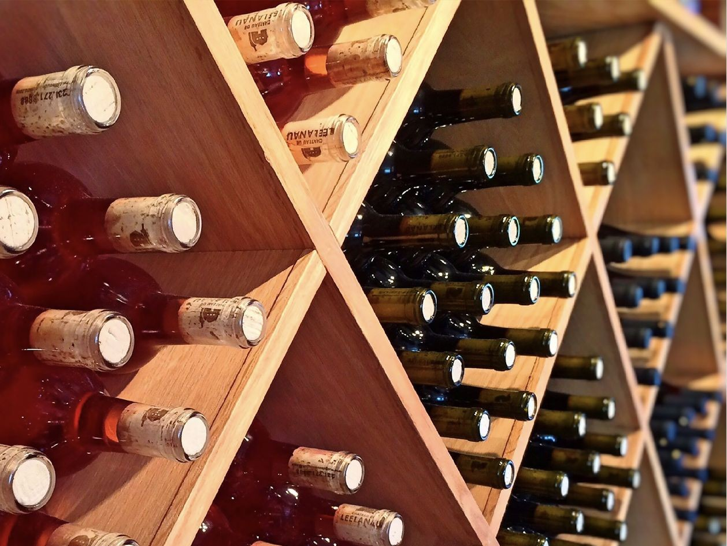

Slide 2
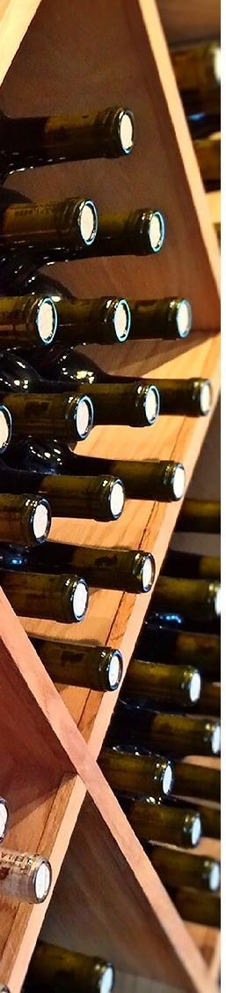
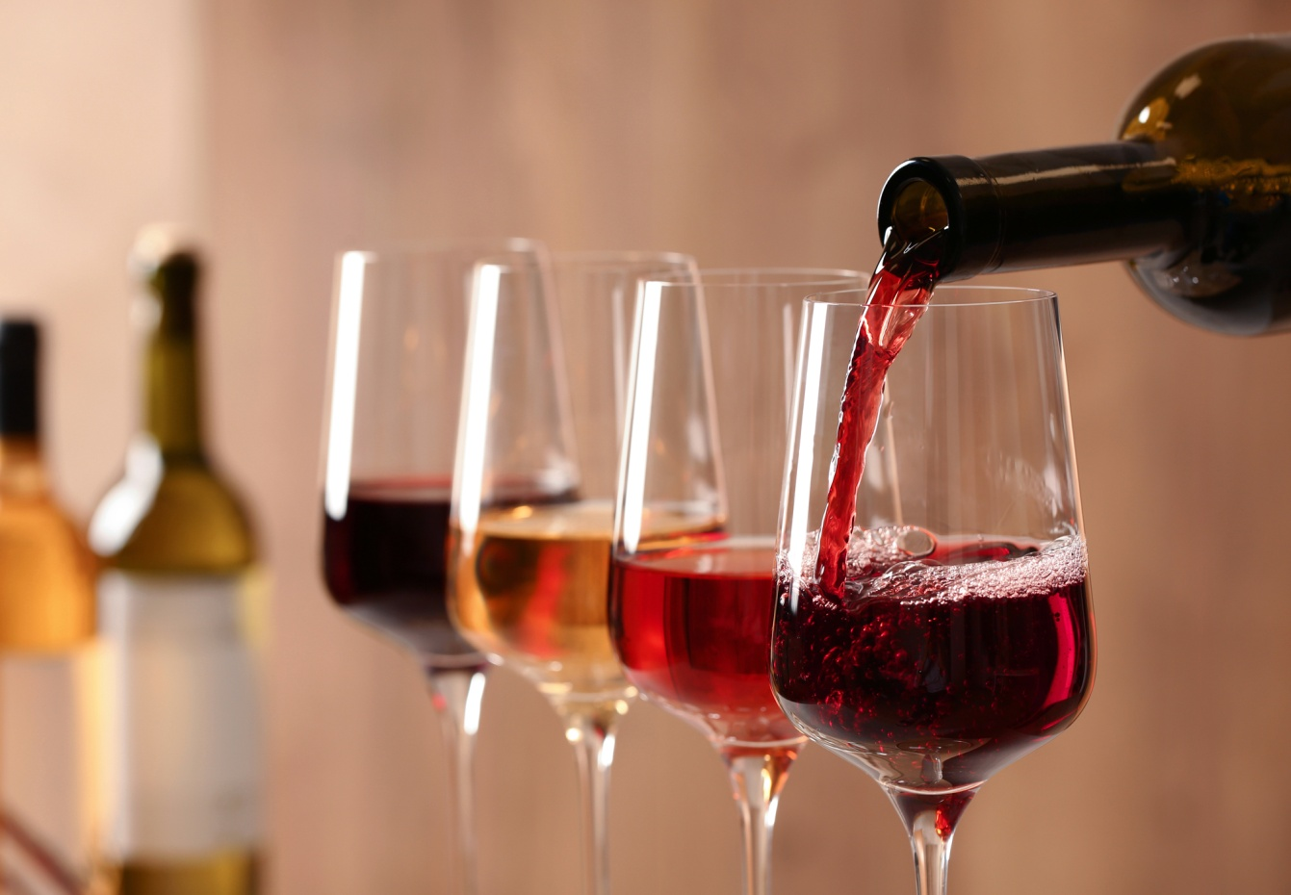
WINE QUALITY PREDICTION BY USING MACHINE LEARNING ALGORITHMS
PINNAPUREDDY DILEEP
177Y1A1209

Slide 3
Agenda
The aim of this project is to predict the quality of wine on a scale of accuracy given a set of features as inputs. The dataset used is Wine Quality Data set from UCI Machine Learning Repository. My automated predicted system provides accurate prediction values ,accurate training ,testing set values that impacts in the getting overall accurate predicted values of the wine.
MACHINE LEARING ALGORITHMS
1) Random Forest
2) Stochastic Gradient Descent
3) SVC
4)Logistic Regression.

Slide 4
Data Overview
The goal of this project is to determine wine quality based on the chemical properties listed in dataset.
Input variable: based on physicochemical tests
Output variable: based on sensory data, median of at least 3 evaluations made by classifiers.

Slide 5
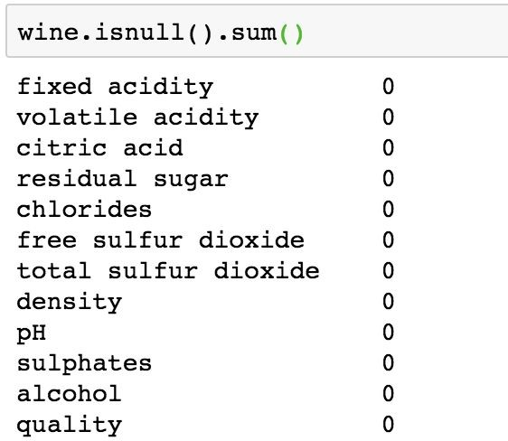
Features
Fixed acidity
Volatile acidity
Citric acid
Residual sugar
Chlorides
Free sulfur dioxide
Total sulfur dioxide
Density
PH
Sulphates
Alcohol

Slide 6
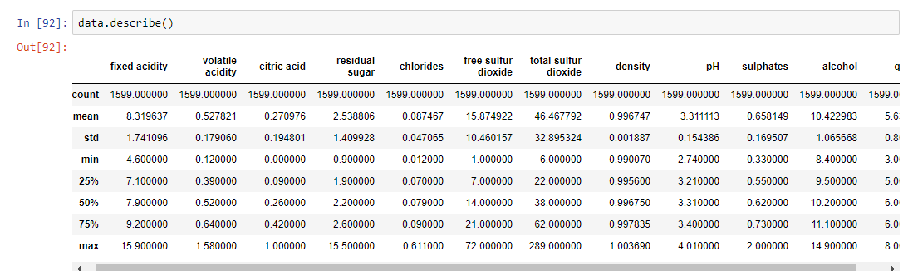
Dataset details

Slide 7
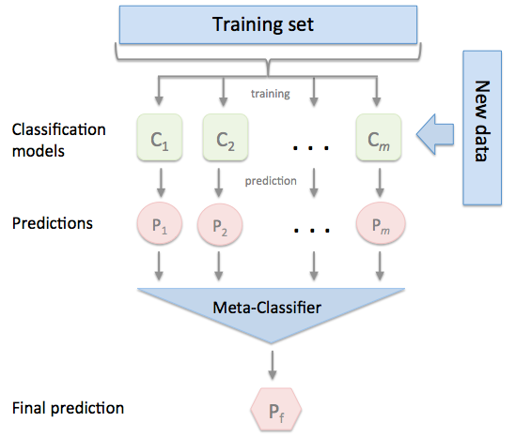
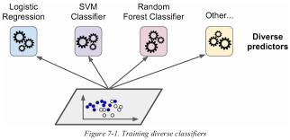
Overview of project

Slide 8
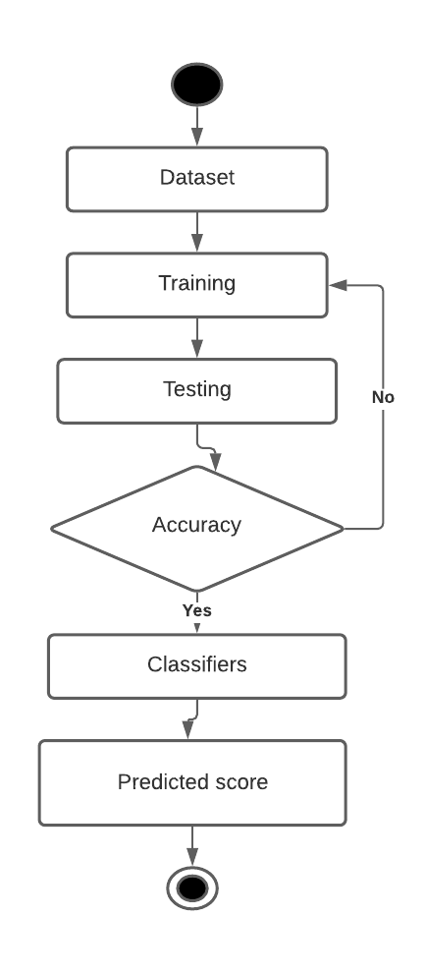
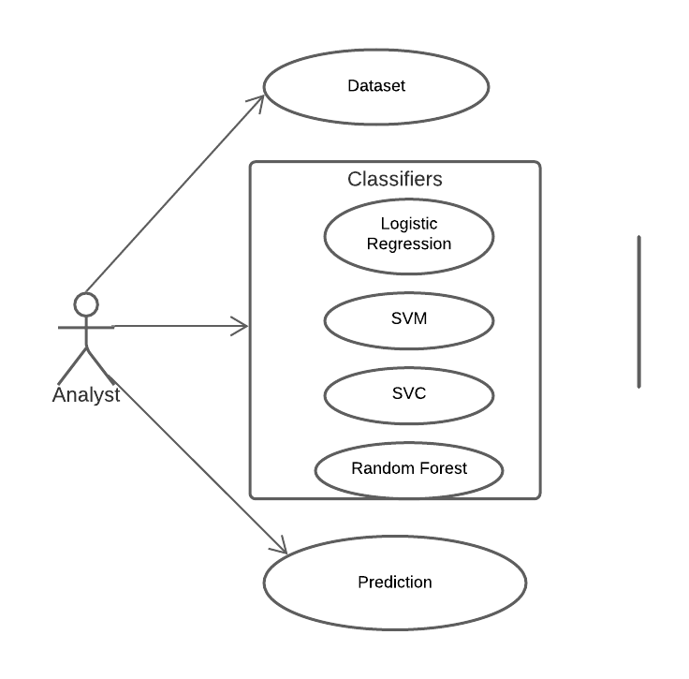
Flow graphs
Flow diagram of the project
Activity diagram

Slide 9
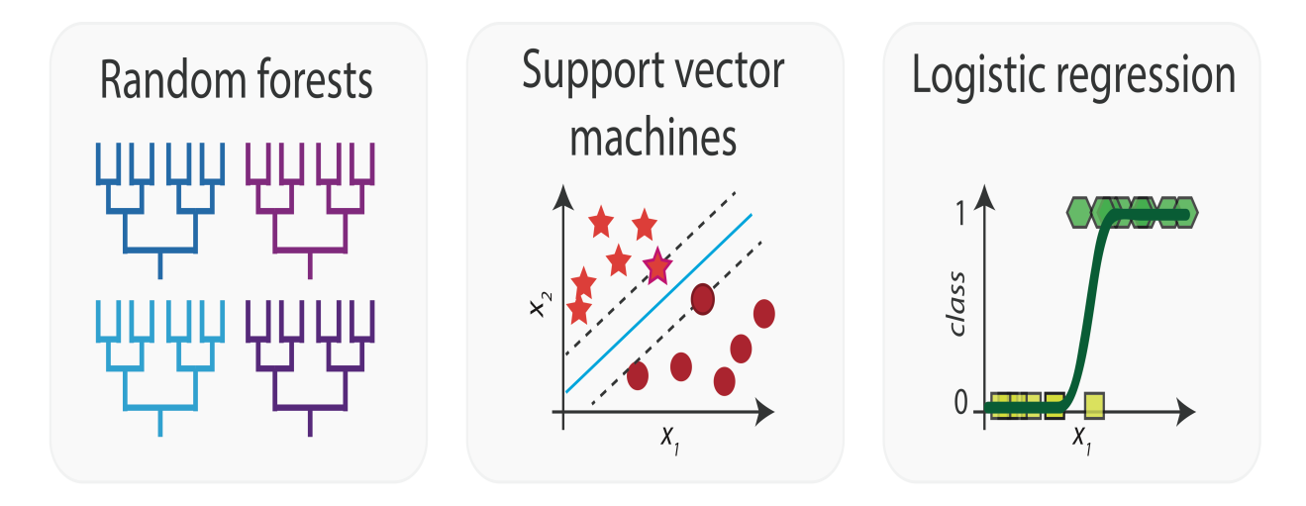
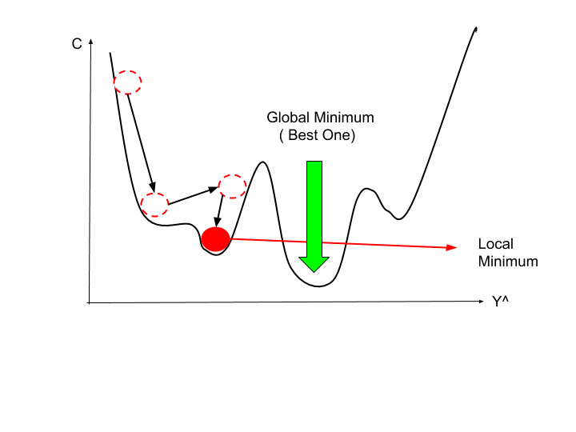
classifiers
Stochastic descent
The above classifiers are used in the wine quality prediction

Slide 10

fixed acidity
volatile acidity
citric acid
residual sugar
chlorides
free sulfur dioxide
sulphates
alcohol
PH
total sulfur dioxide
density

Slide 11
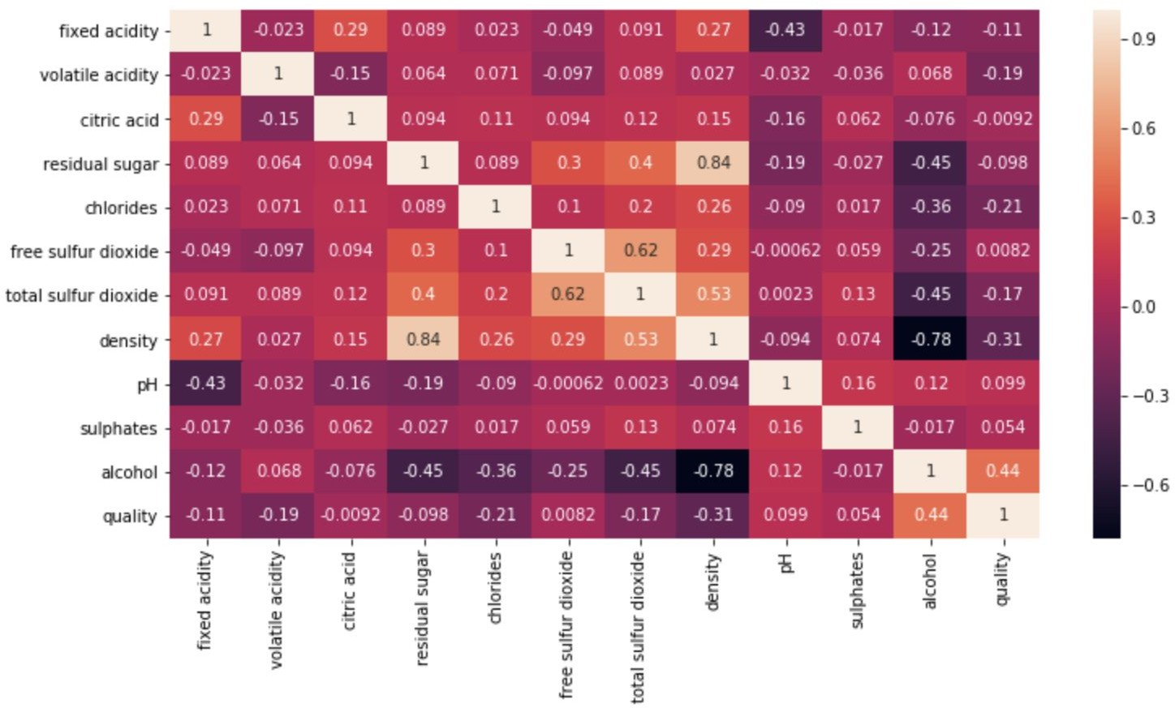
Variable Correlation Matrix

Slide 12
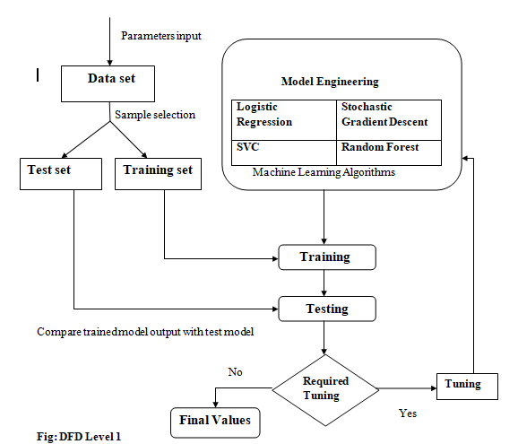
Modeling Process

Slide 13
Validation Accuracy
Random Forest performs the best on validation

Slide 14
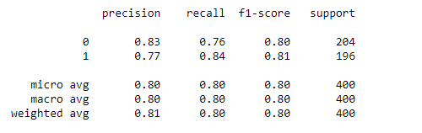
RF on Testing Accuracy
Here the accuracy shows about 80%

Slide 15
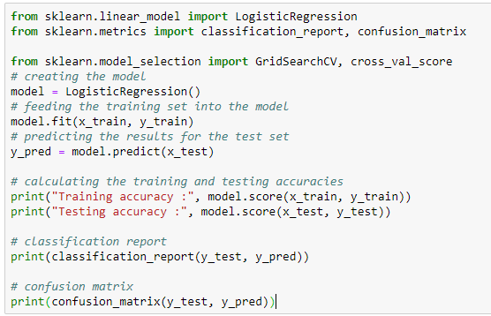
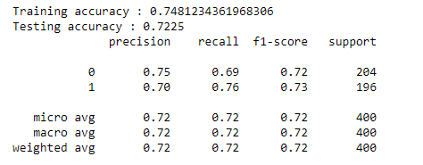
Logistic Regression
Logistic Regression output

Slide 16
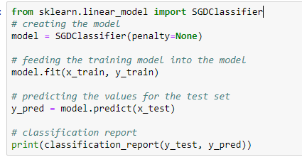
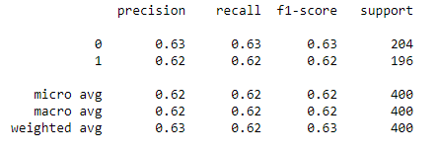
Stochastic Gradient Descent
Stochastic Gradient Descent output

Slide 17
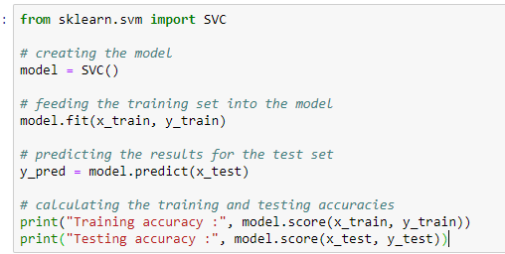
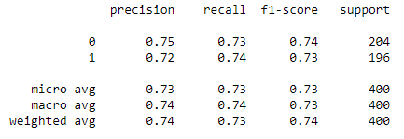
Support Vector Machine
SVM output

Slide 18
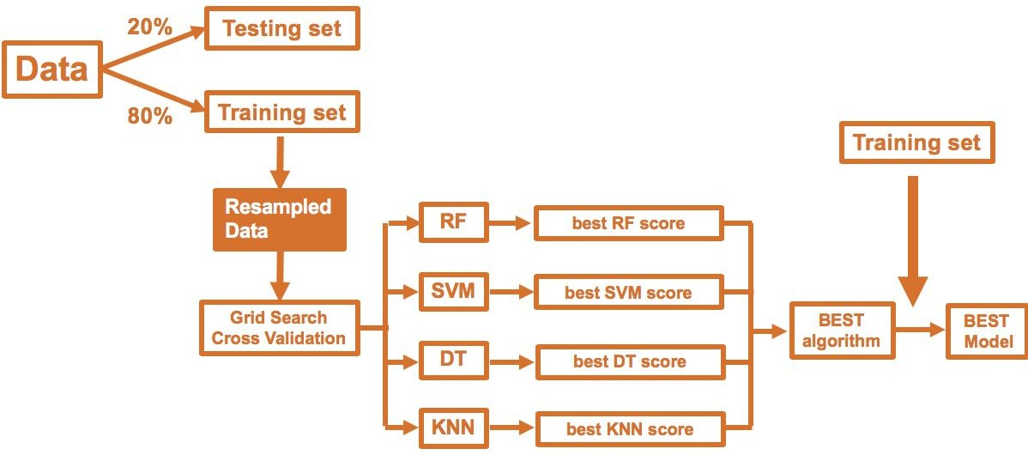
Similar Process
LR
best LR score
SGD
best SGD score

Slide 19
Validation Accuracy
Random Forest is still the best.

Slide 20
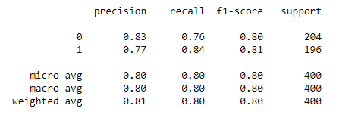
RF Confusion Matrix
Here random forest depicts higher accuracy among others.

Slide 21
Thank you !
Q&A

